Slide 1

Setup Utility
Insyde Software March 2021

Slide 2
Copyright 2021 Insyde Software Corp., All Rights Reserved.
No part of this publication may be reproduced, transmitted, transcribed, stored in a retrieval system, or translated into any language or computer language, in any form, or by any means, electronic, mechanical, magnetic, optical, chemical, manual or otherwise, without the prior written permission of Insyde Software Corp.
Disclaimer
Insyde Software Corp. (“Insyde”), provides this document and the programs "as is" without warranty of any kind, either expressed or implied, including, but not limited to, the implied warranties of merchantability or fitness for a particular purpose.
This document may contain technical inaccuracies or typographical errors. Changes are periodically made to the information herein; these changes will be incorporated in future revisions of this document. Insyde is under no obligation to notify any person of the changes. Some code names featured in this document are used to identify products that are in development and not yet publicly announced for release. Insyde is not obligated for its accuracy or completeness.
This document may contain third party’s information, features, schedules, code names, and product names, which are based on Insyde’s interpretation available as of the creation of this document and may be changed from time to time. Neither Insyde nor the third party is obligated to notify such change. If you are interested in third party’s information, you may contact the local third party sales office or the local distributor to obtain the latest specifications. All the intellectual property right of any third party information remains to its owner or steward.

Slide 3
Agenda
Goals & Target Audience
Overview
Related Files
Reserved Word of VFR file
Setup Customization
Label
Internal Use

Slide 4
Goals & Target Audience

Slide 5
Goals & Target Audience
Target Audience:
BIOS developers who use InsydeH2O 5.4 (EDK II) to create their firmware products.
Goals:
Know how to add/change setup items in InsydeH2O 5.4.
Requirements:
InsydeH2O 5.4 source code

Slide 6
Overview

Slide 7
Overview
Form: A description of a page or pages which describe fields for user input.
VFR: Visual Forms Representation. This is the source code format that is used by developers to create a user interface with varying pieces of data and/or questions.
HII: Human Interface Infrastructure. This generally refers to the database which contains string, font, and IFR information along with other pieces which use one of the database components.
IFR: Internal Forms Representation. This is the binary encoding that is used for the representation of a user interface page(s).

Slide 8
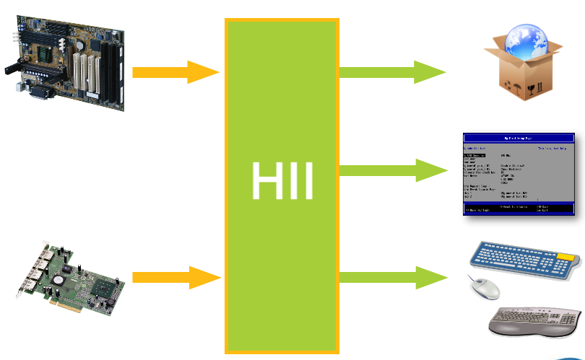
Human Interface Infrastructure (HII)
Comprised of several components:
Database
Data Structures
Browser Engine
Developers use HII to communicate a standardized user interface

Slide 9
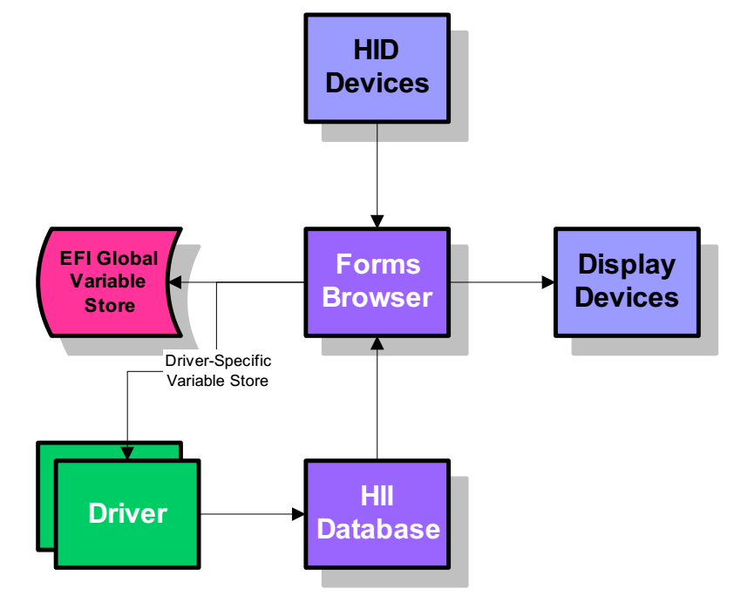
Human Interface Infrastructure (HII)

Slide 10
Setup & HII
Setup Driver
Source
Input
HII
VFR
SetupUtility
SendForm
Callback
Strings
unicode file
Output
Compile
Runtime
User

Slide 11
Related Files

Slide 12
Related Files
SetupUtilityLib
Insyde/InsydeModulePkg/Library/SetupUtilityLib/SetupUtilityLib.inf
SetupUtility Initialize
Intel/EagleStream/$(CHIPSET_PKG)/UefiSetupUtilityDxe/SetupUtilityDxe.inf
Callback functions
Intel/EagleStream/$(CHIPSET_PKG)/UefiSetupUtilityDxe/Advance/Advance.c
Intel/EagleStream/$(CHIPSET_PKG)/UefiSetupUtilityDxe/Power/Power.c
Insyde/InsydeModulePkg/Library/SetupUtilityLib/Boot/Boot.c
Insyde/InsydeModulePkg/Library/SetupUtilityLib/Exit/Exit.c
Insyde/InsydeModulePkg/Library/SetupUtilityLib/Main/Main.c
Insyde/InsydeModulePkg/Library/SetupUtilityLib/Security/Security.c

Slide 13
Related Files
VFR file
Intel/EagleStream/$(CHIPSET_PKG)/UefiSetupUtilityDxe/Advance/AdvanceVfr.vfr
Intel/EagleStream/$(CHIPSET_PKG)/UefiSetupUtilityDxe/Power/PowerVfr.vfr
Insyde/InsydeModulePkg/Library/SetupUtilityLib/Boot/BootVfr.vfr
Insyde/InsydeModulePkg/Library/SetupUtilityLib/Exit/ExitVfr.vfr
Insyde/InsydeModulePkg/Library/SetupUtilityLib/Main/MainVfr.vfr
Insyde/InsydeModulePkg/Library/SetupUtilityLib/Security/SecurityVfr.vfr
Unicode file - String definition
Intel/EagleStream/$(CHIPSET_PKG)/UefiSetupUtilityDxe/SetupVfrStrings.uni
Insyde/InsydeModulePkg/Library/SetupUtilityLib/SetupUtilityLibString.uni

Slide 14
Reserved Word of VAR file

Slide 15
formset / endformset
This command is used to define the beginning and end of a set of forms.
#define SYSTEM_CONFIGURATION_GUID {0xA04A27f4, 0xDF00, 0x4D42, 0xB5, 0x52, 0x39, 0x51, 0x13, 0x02, 0x11, 0x3D}
formset
guid = SYSTEM_CONFIGURATION_GUID,
title = STRING_TOKEN(STR_MAIN_TITLE),
help = STRING_TOKEN(STR_BLANK_STRING),
class = SETUP_UTILITY_CLASS,
subclass = SETUP_UTILITY_SUBCLASS,
…
endformset;

Slide 16
form / endform
This command is used to define the beginning and end of a page of user interface data.
form
formid = ROOT_FORM_ID,
title = STRING_TOKEN(STR_MAIN_TITLE);
…
endform;

Slide 17
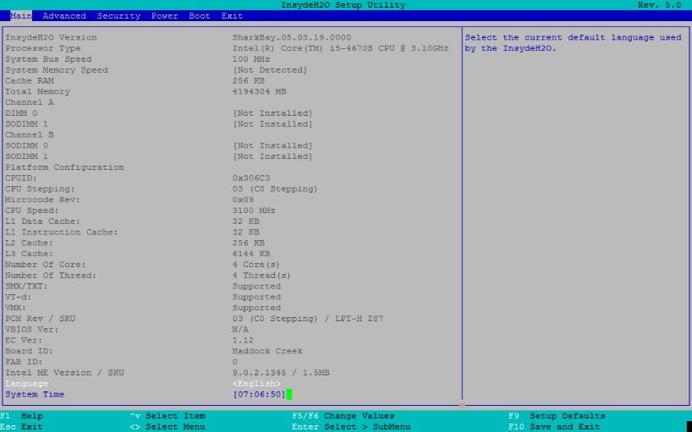
Illustration

Slide 18
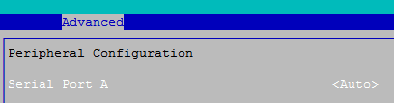
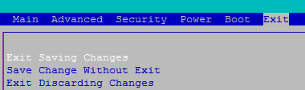
subtitle
Subtitle strings are intended to be used by authors to separate sections of questions into semantic groups
subtitle text = STRING_TOKEN(STR_PERIP_CONFIG_STRING);
subtitle text = STRING_TOKEN(STR_BLANK_STRING);

Slide 19
text
A simple usage case where a static string is being printed
A use case which is more complex and allows for a one-time callback to acquire the secondary text data
text
text = STRING_TOKEN(STR_BLANK_STRING);
text
help = STRING_TOKEN(STR_EXIT_SAVING_CHANGES_HELP),
text = STRING_TOKEN(STR_EXIT_SAVING_CHANGES_STRING),
text = STRING_TOKEN(STR_BLANK_STRING),
flags = INTERACTIVE,
key = KEY_SAVE_EXIT;

Slide 20
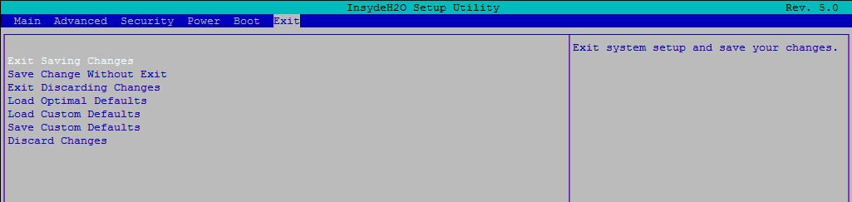
Illustration

Slide 21
oneof / endoneof
This command provides the ability to choose from multiple choices. Each of the choices is defined by an option statement.
oneof
varid = SystemConfig.QuickBoot,
prompt = STRING_TOKEN(STR_QUICK_BOOT_STRING),
help = STRING_TOKEN(STR_QUICK_BOOT_HELP),
option text = STRING_TOKEN(STR_ENABLED_TEXT), value = 1, flags = DEFAULT;
option text = STRING_TOKEN(STR_DISABLED_TEXT), value = 0, flags = 0;
endoneof;

Slide 22
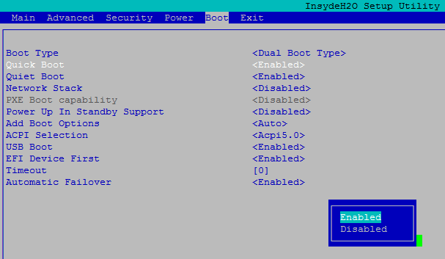
Illustration

Slide 23
numeric / endnumeric
This command allows for numeric entries by selecting from numeric choices. The step portion of the numeric command allows for defining the rate the value increments when selecting the next or previous entry. If the step is set to zero, the user will be prompted for manual input of the numeric value.
numeric
varid = SystemConfig.CoreExtraTurboVoltage,
prompt = STRING_TOKEN (STR_CORE_EXTRA_TURBO_VOLTAGE_STRING),
help = STRING_TOKEN (STR_CORE_EXTRA_TURBO_VOLTAGE_HELP),
flags = INTERACTIVE,
minimum = 0,
maximum = 2000,
step = 1,
default = 1200,
endnumeric;

Slide 24
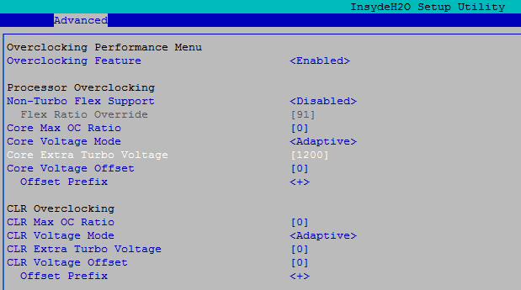
Illustration

Slide 25
goto
This command allows the user to jump to a new page. In terms of HTML operations, this behaves exactly like a hyper-link. The target for a goto command is going to be a form
goto 0x21,
prompt = STRING_TOKEN(STR_BOOT_CONFIG_STRING),
help = STRING_TOKEN(STR_BOOT_CONFIG_HELP);

Slide 26
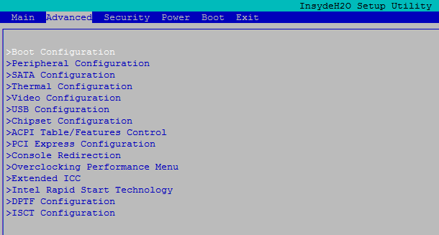
Illustration

Slide 27
suppressif
This tag causes the following tag to be hidden from the user if the Boolean expression evaluates to true.
suppressif
ideqvallist SystemConfig.ComPortA == 0 1;
oneof
varid = SystemConfig.ComPortABaseIo,
questionid = KEY_SERIAL_PORTA_BASE_IO,
prompt = STRING_TOKEN(STR_BASEIO_STRING),
help = STRING_TOKEN(STR_BLANK_STRING),
…
endoneof;
…
endif;

Slide 28
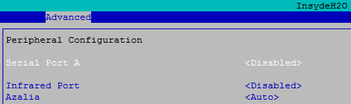
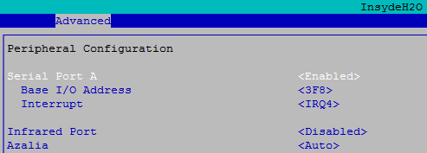
Illustration

Slide 29
grayoutif
This tag causes the following tag to be displayed in a special display form used for inaccessible options if the Boolean expression evaluates to true.
grayoutif
ideqval SystemConfig.IdeController == 0;
oneof
varid = SystemConfig.SataCnfigure,
prompt = STRING_TOKEN(STR_HDC_CONFIGURE_TYPE_STRING),
help = STRING_TOKEN(STR_HDC_CONFIGURE_TYPE_HELP),
…
endoneof;
…
endif;

Slide 30
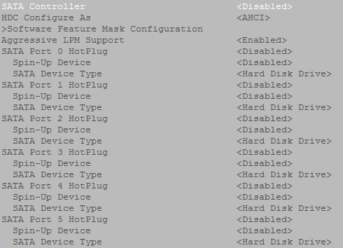
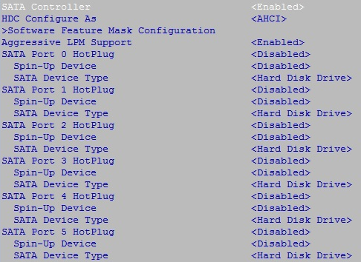
Illustration

Slide 31
Setup Customization

Slide 32
Setup Customization
Use VFR to describe Form according to platform requirement
Steps:
Add new option in a form
Define string and data structure
Enable callback for the option (optional)
Set callback function (optional)

Slide 33
Add new option in a Form
Intel\EagleStream\$(CHIPSET_PKG)\UefiSetupUtilityDxe\Advance\ AdvanceVfr.vfr
Example : MyTest Option
oneof
varid = SystemConfig.MyTest,
prompt = STRING_TOKEN(STR_MYTEST_STRING),
help = STRING_TOKEN(STR_MYTEST_HELP),
option text = STRING_TOKEN(STR_ENABLED_TEXT), value = 1, flags = DEFAULT;
option text = STRING_TOKEN(STR_DISABLED_TEXT), value = 0, flags = 0;
endoneof;

Slide 34
String & Data Structure Define
Intel\EagleStream\$(CHIPSET_PKG)\UefiSetupUtilityDxe\ SetupVfrStrings.uni
Board\Intel\$(PROJECT_PKG)\Include\SetupConfig.h & Intel\EagleStream\$(CHIPSET_PKG)\Include\ChipsetSetupConfig.h
#string STR_MYTEST_STRING #language en-US " MyTest "
#string STR_MYTEST_HELP #language en-US " … "
#string STR_ENABLED_TEXT #language en-US "Enabled "
#string STR_DISABLED_TEXT #language en-US " Disabled"
typedef struct {
…
UINT8 MyTest;
UINT8 ODMRSV[126];
} SYSTEM_CONFIGURATION;
typedef struct {
…
UINT8 ODMRSV[127];
} SYSTEM_CONFIGURATION;

Slide 35
Enable Callback for the option
Set callback flag and key value in VFR file
Example : Enable callback function for MyTest option
oneof
varid = SystemConfig.MyTest,
prompt = STRING_TOKEN(STR_MYTEST_STRING),
help = STRING_TOKEN(STR_MYTEST_HELP),
questionid = KEY_MY_TEST,
option text = STRING_TOKEN(STR_ENABLED_TEXT), value = 1, flags = INTERACTIVE | DEFAULT;
option text = STRING_TOKEN(STR_DISABLED_TEXT), value = 0, flags = INTERACTIVE;
endoneof;

Slide 36
Enable Callback for the option
Board\Intel\$(PROJECT_PKG)\Include\SetupConfig.h
Intel\EagleStream\$(CHIPSET_PKG)\UefiSetupUtilityDxe\Advance\ Advance.c
//
// Callback key value
//
#define KEY_MY_TEST 0x6666
AdvanceCallbackRoutine () {
…
switch (QuestionId) {
case KEY_MY_TEST:
… // put your code here
break;
…
}

Slide 37
Label

Slide 38
Label
Create items dynamically
Steps:
Define label
Create Op Code
HiiCreateSubTitleOpCode ()
HiiCreateTextOpCode ()
HiiCreateOneOfOpCode ()
…
UpdateForm
Example: Language in Main Menu

Slide 39
Label
Insyde\InsydeModulePkg\Library\SetupUtilityLib\ Main\MainVfr.vfr
Insyde\InsydeModulePkg\Include\KernelSetupConfig.h
title = STRING_TOKEN(STR_MAIN_TITLE);
label SETUP_UTILITY_LANG_MENU;
//
// Misc labels
//
#define SETUP_UTILITY_LANG_MENU 0x1001

Slide 40
Label
Insyde\InsydeModulePkg\Library\SetupUtilityLib\ Main\Main.c
In function UpdateLanguage ()
StartLabel = HiiCreateGuidOpCode (StartOpCodeHandle, &gEfiIfrTianoGuid, NULL, sizeof (EFI_IFR_GUID_LABEL));
StartLabel->ExtendOpCode = EFI_IFR_EXTEND_OP_LABEL;
StartLabel->Number = SETUP_UTILITY_LANG_MENU;
HiiCreateOneOfOpCode (
StartOpCodeHandle,
KEY_LANGUAGE_UPDATE,
CONFIGURATION_VARSTORE_ID,
VarOffset,
STRING_TOKEN (STR_LANGUAGE_PROMPT),
STRING_TOKEN (STR_LANGUAGE_HELP),
EFI_IFR_FLAG_CALLBACK,
EFI_IFR_NUMERIC_SIZE_1,
OptionsOpCodeHandle,
NULL
);
HiiUpdateForm (
HiiHandle,
NULL,
ROOT_FORM_ID,
StartOpCodeHandle,
NULL
);
HiiFreeOpCodeHandle (StartOpCodeHandle);

Slide 41
Thanks!

